Slide 1


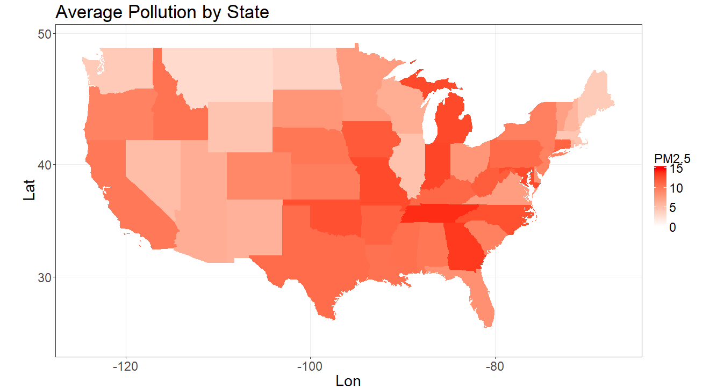
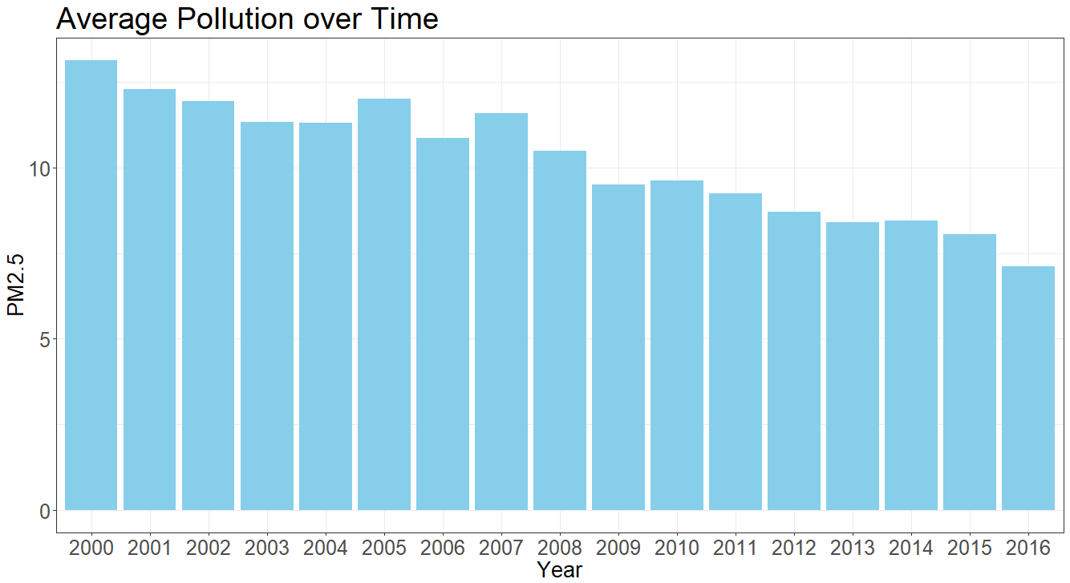
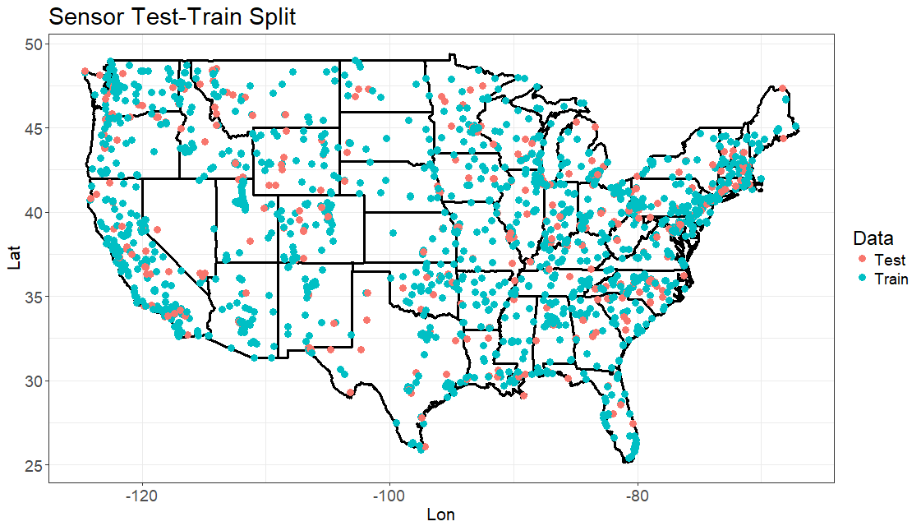
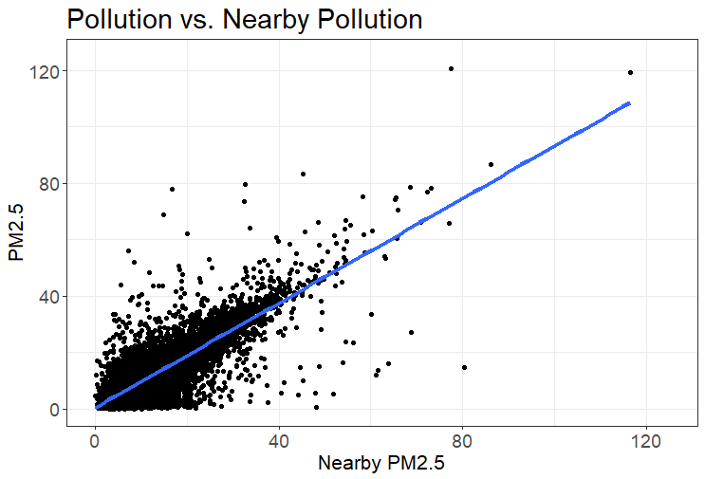
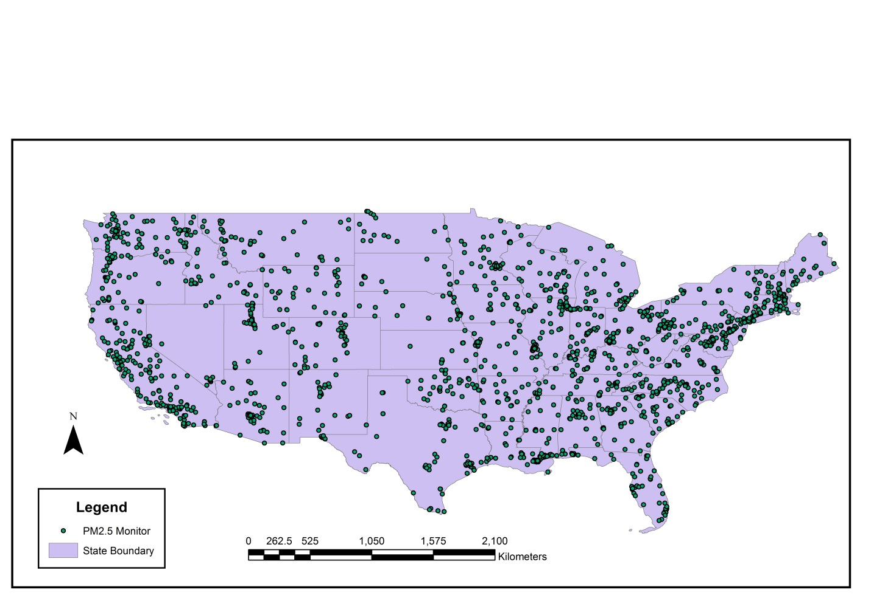
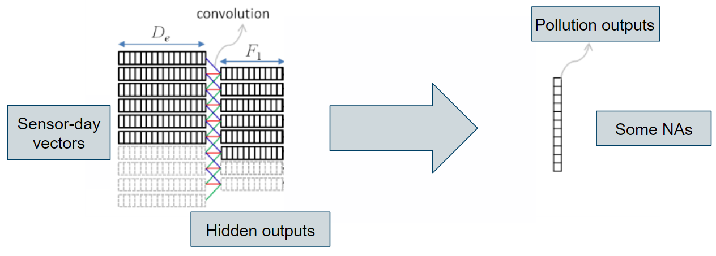
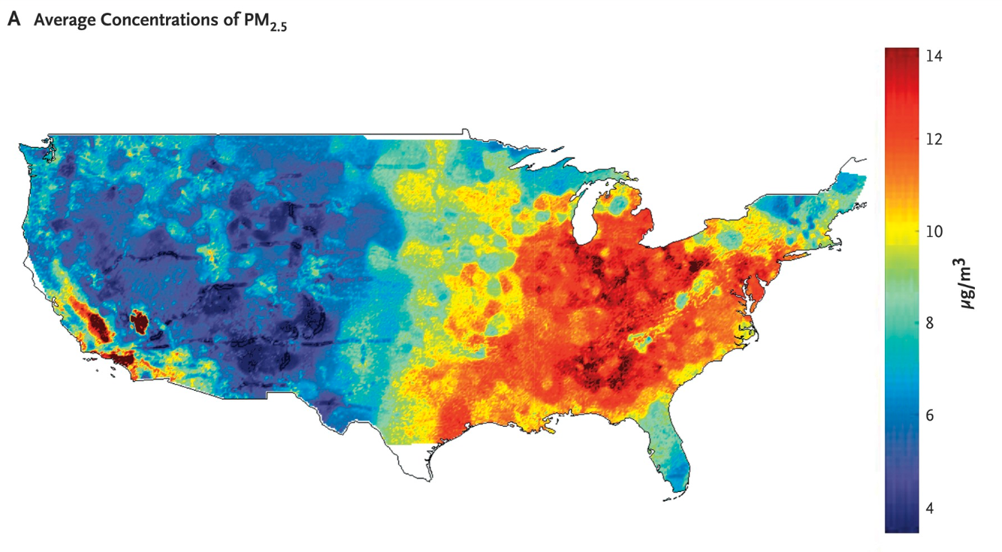
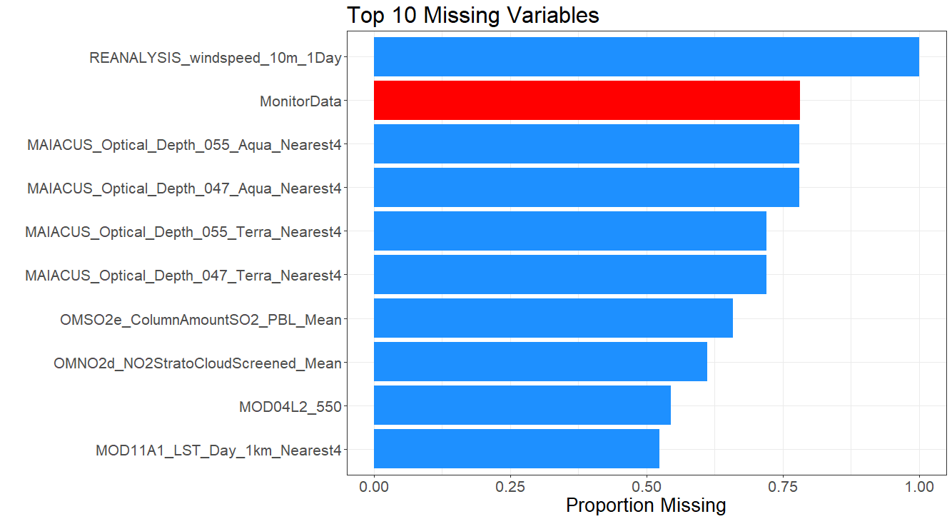
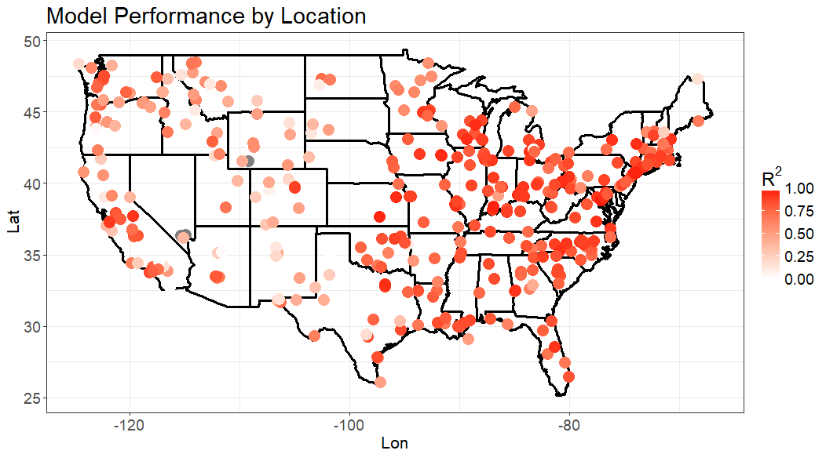
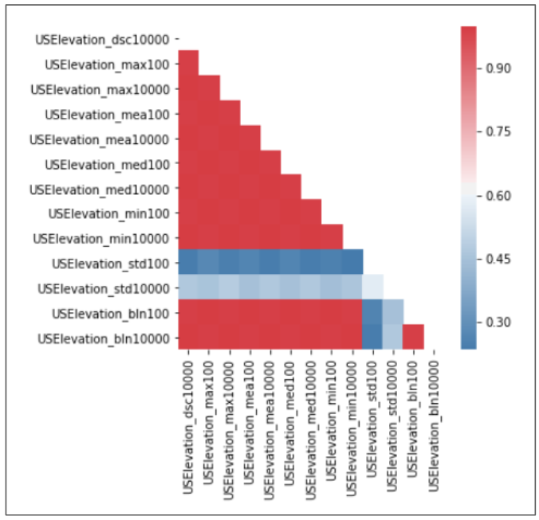
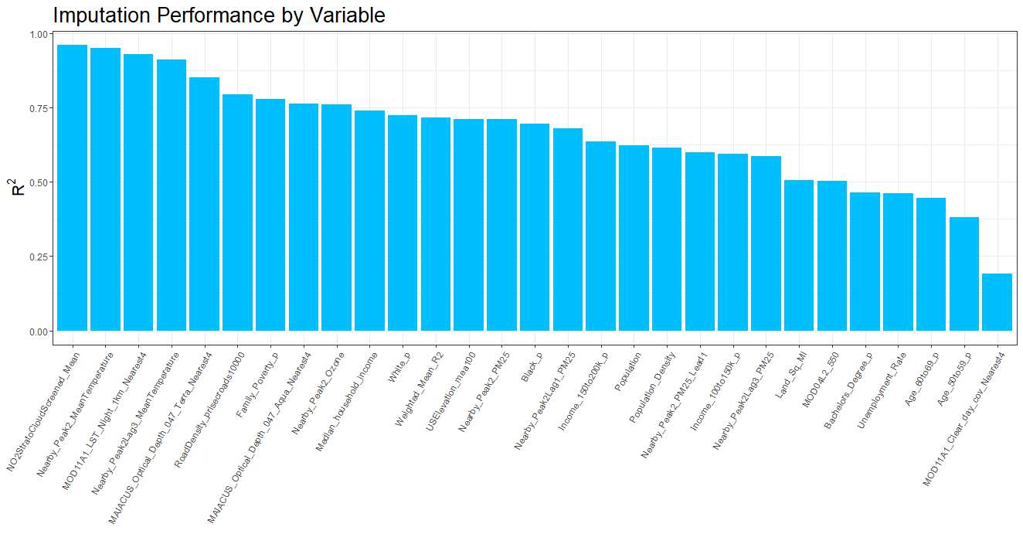
Air Pollution Predictions
Members: Keyan Halperin, Christopher Hase, Justin Lee, Casey Meehan Mentor: David Sondak Partner: Harvard School of Public Health
Background
Exploratory Data Analysis
Modeling
PM_{2.5} - fine particles with a diameter of 2.5 μm or less - is measured at approximately 2,000 air pollution monitors located throughout the US. However, these monitors are costly to operate and thus, sparsely distributed. Consequently, the air quality is not known for many locations throughout the country. This is problematic for public health studies since we cannot estimate the overall effect that pollution has on health if we do not know what the pollution is in many areas with any degree of certainty.
Thus, using pollution data from these sparsely distributed sensors along with several other types of data, our goal was to fit a model that accurately interpolates pollution throughout the entire US. With this, it would be possible to create of a continuous map of pollution on the daily level. This map could be used by researchers to establish causal relationships between pollution and health outcomes, among several other potential research applications.
We also conducted a thorough exploratory data analysis to gain insights that would help us in modeling. Most notably, we discovered that PM_{2.5} has strong spatial and temporal dependencies. Below are plots of average PM_{2.5} levels by state and average PM_{2.5} levels over time that demonstrate this.
After pre-processing and imputation, we proceeded with the model tuning, training, and testing process. We trained our models on a random 80% sample of sensors, and we reserved the remaining sensors to test the performance of our models. We also tuned all hyper-parameters using K-fold cross-validation.
Based on the correlations between each of the predictors and PM_{2.5}, by far the most important linear predictor of PM_{2.5} was nearby PM_{2.5}. Thus, our baseline model was just a simple linear regression with nearby PM_{2.5} as the only predictor. Despite its simplicity, this model does surprisingly well with a test R² of 0.712. Above is a scatterplot of the relationship between PM_{2.5} and nearby PM_{2.5} on a random 1% subset of the data.
Thus, there is strong evidence to suggest that we should implement models that incorporate take into account spatial and temporal relationships.
Imputing Missing Data
A major obstacle that we had to overcome was the amount of missing data. Many of the variables and almost all observations had some missing data. Even PM_{2.5} itself was often missing since the monitors do not collect pollution data every day.
.
Because days that are close together are likely to be related in ways that are relevant to pollution, we decided to implement a CNN. In particular, we used a kernel width of size 3 so that features from the previous day, current day, and day after are used for predicting pollution on any given day. After tuning the relevant parameters, we obtained an R² of x, giving us our best results! (still getting final results, will go into more detail for final draft)
Data
 | OLS | Ridge | RF | XGBoost | CNN | Ensemble
R² | 0.71 | 0.73 | 0.78 | 0.78 | x | 0.78
Monitor Data
Pollution readings from approximately 2,000 PM_{2.5} sensors every day for the past 16 years.
Below is the performance of our best model by location. Unsurprisingly, our model has much better predictive performance in regions with more sensors nearby. This highlights the need for to have more monitors installed.
Satellite Data
Pollution readings from approximately 2,000 PM_{2.5} sensors every day for the past 16 years.
Weather Data
Pollution readings from approximately 2,000 PM_{2.5} sensors every day for the past 16 years.
Because of the volume of data that was missing and its potential importance for modeling PM_{2.5}, we could not afford to ignore it. After some research and experimentation, we decided to implement an iterative imputation algorithm called MissForest (Stekhoven & Bühlmann, 2012). After some modifications to the algorithm and creating a scheme for validating the quality of our imputations, we obtained accurate imputations. Below is a plot of the imputation performance for each post variable selection feature with missing values as measured by R². (we will go into more detail on MissForest for final draft)
US Census Data
Various demographic variables on the Zip code level as collected by the US Census.
Because of the high number of variables, we decided to perform variable selection. Having extraneous or redundant variables not only increases the computation time, but it can also harm the predictive performance of machine learning models. To reduce dimensionality, for each set of highly correlated features, we removed all but one. We also removed variables that had non-significant partial correlations with PM_{2.5}
Below you can see a set of variables for which there were many high pairwise correlations.
Discussion
One result we have consistent throughout our analyses and modeling is the disproportionate importance of one variable, nearby PM_{2.5}. Despite having many additional variables, the strong performance of our imputation procedure, and the complex models that we implemented, we were unable to improve model performance substantially beyond a model that uses nearby PM_{2.5} as its only feature. We think that this is because the other available data is just not particularly predictive of PM_{2.5} after having already taken into consideration nearby PM_{2.5}. Consequently, we believe that in order to obtain accurate predictions of PM_{2.5} throughout the US, it is absolutely essential for more pollution monitors to be installed, especially in regions where there are few.
We also have evidence to suggest that our imputation procedure provides high quality imputations. The procedure is quite easy to implement, so we recommend that HSPH consider using it in the future.

